Slide 1

HDB Resale Price Analysis:
Model Prediction and Link Analysis
Samiha Hossain

Slide 2


The Foundation: Key Assumptions
Market Efficiency
Models were made on the premise that resale prices reflect fundamental drivers such as location and flat type, serving as a reliable gauge for market sentiment.
Homogeneity within towns
Models were made on the premise that flats within the same town are comparable to simplify the model. This takes factors like proximity to amenities and transport out of the equation.

Slide 3
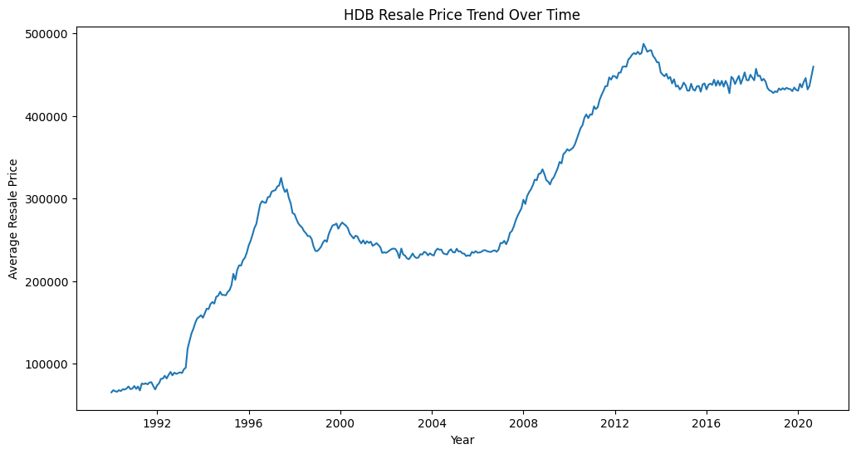
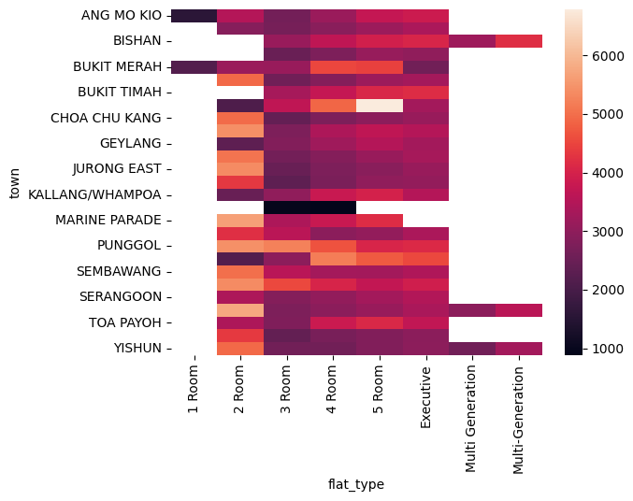
Data Exploration & Preparation Pipeline
Data Consolidation and cleaning
Consolidation of 30+ years of resale transaction records and cleaning to standardize data across the years.
Feature Engineering
Deriving 'Remaining Lease’ for rows which didn’t have it and 'Storey Lower’
Exploratory Data Analysis
Plotting the variation of resale price across different features to determine important features.
Model Pipeline
Preprocessed numerical and categorical data respectively and split the data for training and testing with Linear regression and XGBoost
Feature Selection
Strategic selection of features based on EDA.

Slide 4
Models Explored: Linear vs. XGBoost
Linear Regression
Baseline Model
0.81
MAE: 49996.21
RMSE: 65080.35
R²: 0.8072
Reliable but limited in
capturing complexity.
XGBoost
The Winner
0.98
MAE: 16084.24
RMSE: 23204.73
R²: 0.9755
Able to capture non-linear relationships
XGBoost outperformed the baseline by significantly reducing Mean Absolute Error and explaining more variance.

Slide 5
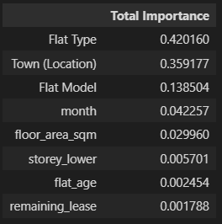
Findings:
42%
Flat Type
The most influential factor in pricing.
36%
Town
Second primary driver of market valuation.
Structural Premium
Based on model findings, the key drivers of resale prices are identified to be the Flat type and the Town.
Town accounts for location-based pricing premiums, while flat type (particularly larger units like 5-room and executive flats) commands structural price premiums due to size and amenities.

Slide 6

Potential Policies to address Housing Prices Inflation
Increase supply of HDBs in High premium towns
By increasing supply, prices in premium towns should normalize downward as scarcity premium dissipates. The geographic price differential between premium and peripheral towns would compress, improving overall affordability.
Cons/ Trade-offs:
Implementation timelines are lengthy (3-5+ years for construction), requiring sustained policy commitment.
Supply expansion requires significant capital and land availability, potentially diverting resources from other infrastructure priorities
Notes:
Looking at temporal trends, we see that lease decay is a critical factor, and the market has maintained a steady 3.5% growth rate over 30 years. This resilience is a hallmark of the HDB ecosystem.

Slide 7






Future Exploration:
Including proximity-based features in modelling: Proximity to MRT stations, schools, bus stops, malls, parks
Impact of Macroeconomic and global events on housing prices: Government policies, financial crises, pandemics

